Slide 1


Improved Inner-product Encryption with Adaptive Security and Full Attribute-hiding
Jie Chen, Junqing Gong, and HoeteckWee
Asiacrypt2018 December 02-06, 2018
Brisbane, Australia

Slide 2
Outline
Introduction
Adaptive Security
OT IPE
XDLIN assumption
Function
Security game
Comparison

Slide 3
Adaptive Security
Adaptive Security(crypto) | Adaptive Security(安全系統)
query會學習先前的結果 | 根據環境變動調整參數

Slide 4
Okamoto and Takashima IPE
DLIN assumption
Adaptively secure and fully attribute-hiding
Dual pairing vector spaces

Slide 5











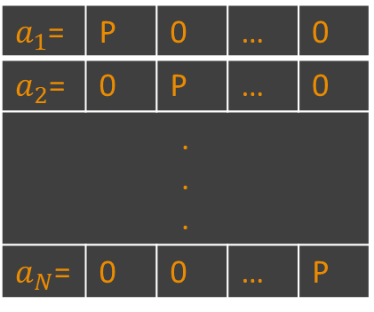

Dual pairing vector spaces
Ex:
$$\left(q,V,V^{∗},G_{T},A,A^{∗},ⅇ\right)$$
$$G_{1}^{N}$$
$$G_{2}^{N}$$
$a_{1}$= | P | 0 | … | 0
$a_{2}$= | 0 | P | … | 0
. . .
$a_{N}$= | 0 | 0 | … | P
Basis: (0,1),(1,0)
Canonical Basis
4*(1,0)
$$A=\left(a_{1},a_{2},⋯,a_{N}\right)$$
+5*(0,1)
$$i−1$$
$$N−i$$
(4*1,5*1)
$$a_{i}=\left(0,0,0,⋯,0,P,0,0,⋯,0\right)$$
$$A^{∗}=\left(a_{1}^{∗},a_{2}^{∗},⋯,a_{N}^{∗}\right)$$
$$i−1$$
$$N−i$$
$$a_{i}^{∗}=\left(0,0,0,⋯,0,Q,0,0,⋯,0\right)$$
$$y=\left(y_{1}Q,…,y_{N}Q\right)=y_{1}a_{1}^{∗}+…+y_{N}a_{N}^{∗} =\vec{y}A^{∗}∈V^{∗}$$
$$x=\left(x_{1}P,…,x_{N}P\right)=x_{1}a_{1}^{}+…+x_{N}a_{N}^{}=\vec{x}A^{}∈V$$

Slide 6




Dual pairing vector spaces
Duality
$x⋅y=\sum_{i=1}^{N}{x_{i}y_{j}}$ $= \vec{x}⋅\vec{y}∈F_{q}$
$e\left(x,y\right)$ $= g_{T}^{x⋅y}∈G_{T}$
Orthonomality
1 if i = j
0 if i != j
$$a_{i}⋅a_{j}^{∗}=δ_{i,j}=$$

Slide 7






本篇
Purpose :Improve OT IPE
XDLIN assumption
Define:
M:matrix
$g$:generator
$${\left[M\right]}_{1}=g_{1}^{M}$$
$$M_{a}∘{\left[M_{b}\right]}_{2}={\left[M_{a}M_{b}\right]}_{2}$$
$${\left[M\right]}_{2}=g_{2}^{M}$$
$${\left[M\right]}_{T}=g_{T}^{M}$$
$$ⅇ\left({\left[M_{a}\right]}_{1},{\left[M_{b}\right]}_{2}\right)={\left[M_{a}M_{b}\right]}_{T}$$

Slide 8


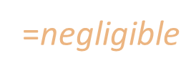

XDLIN assumption
=$\text{negligible}$
猜中-亂猜
$$ⅇ:G_{1}xG_{2}→G_{T}$$

Slide 9
















Function
$Setup\left(1^{λ},n\right):$
$Keygⅇn\left(msk,y\right):$
$Enc\left(mpk,x,m\right):$
$Dⅇc\left(ct_{X},sk_{y}\right):$
$$G=\left(p,G_{1},G_{2},G_{T},ⅇ\right)⇐θ\left(1^{λ}\right)$$
$$U,W_{,1}^{},…,W_{n}⇐Z_{p}^{3×4}$$
$$p=p_{1}p_{2}p_{3}p_{4}$$
$$A⇐Z_{p}^{3×2}$$
$$B_{14}⇐Z_{p}^{4×2}$$
$$k⇐Z_{p}^{3}$$
3X1
$$mpk=\left(G,{\left[A^{T}\right]}_{1},{\left[A^{T}U\right]}_{1},{\left[A^{T}W_{1}\right]}_{1},…,{\left[A^{T}W_{n}\right]}_{1},{\left[A^{T}k\right]}_{T}\right)$$
(G, $G_{1}$,…, $G_{1},G_{T}$)
ms$k=\left(k,W_{1,⋯},W_{n},B_{14}\right)$
$$y=\left(y_{1},…,y_{n}\right)∈Z_{p}^{n}$$
$$r⇐Z_{p}^{2}$$
$$sk_{y}=\left(K_{0}={\left[k+\left(y_{1}⋅W_{1}+…+y_{n}⋅W_{n}\right)B_{14}r\right]}_{2},K_{1}={\left[B_{14}r\right]}_{2}\right)$$
($G_{2}$, $G_{2}$)
$$x=\left(x_{1},…,x_{n}\right)∈Z_{p}^{n}$$
$$s⇐Z_{p}^{2}$$
$$m∈G_{T}$$
$$ct_{x}=\left(C_{0}={\left[s^{T}A^{T}\right]}_{1},C_{1}={\left[s^{T}A^{T}\left(x_{1}⋅U+W_{1}\right)\right]}_{1},…,C_{n}={\left[s^{T}A^{T}\left(x_{n}⋅U+W_{n}\right)\right]}_{1},C={\left[s^{T}A^{T}k\right]}_{T}⋅m\right)$$
($G_{1}$,…, $G_{1},G_{T}$)
$$m^{′}=C⋅ⅇ\left(y_{1}∘C_{1}+⋯{+y}_{n}∘C_{n},K_{1}\right)⋅ⅇ{\left(C_{0},K_{0}\right)}^{−1}$$

Slide 10









Security game
Challenger
Adversary
Setup($1^{λ},n$)
Key Queries
$$y=\left(y_{1},…,y_{n}\right)$$
多次
$$sk_{y}=\left(K_{0},K_{1}\right)$$
Ciphertext
$$\left(x_{0},x_{1},m\right)$$
$$Enc\left(mpk,x_{b},m\right)$$
$$ct_{x_{b}}=\left(C_{0},C_{1},…,C_{n},C\right)$$
$$b^{′}=\left\{0,1\right\}$$
$$Adv_{A}\left(λ\right)=Pr\left[b^{′}=b\right]−\frac{1}{2}$$

Slide 11
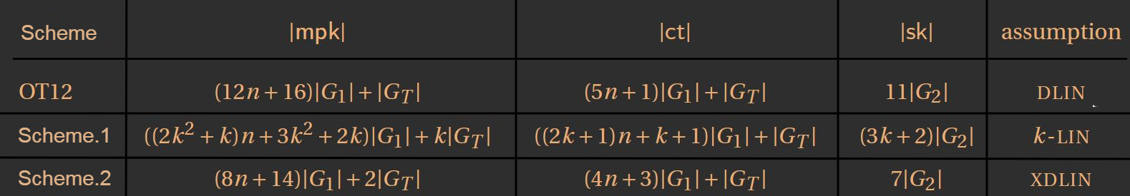
Comparison
Scheme

Slide 12
THANK YOU

Slide 13
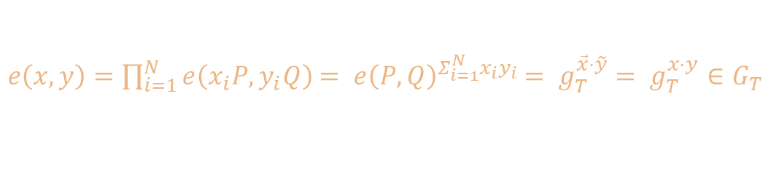
Dual pairing vector spaces
Duality
$x⋅y=\sum_{i=1}^{N}{x_{i}y_{j}}$ $= \vec{x}⋅\vec{y}∈F_{q}$
$e\left(x,y\right)=\prod_{i=1}^{N}{ⅇ\left(x_{i}P,y_{i}Q\right)}$ $= ⅇ{\left(P,Q\right)}^{Σ_{i=1}^{N}x_{i}y_{i}}$ $= g_{T}^{\vec{x}⋅\tilde{y}}$ $= g_{T}^{x⋅y}∈G_{T}$
Orthonomality
1 if i = j
0 if i != j
$$a_{i}⋅a_{j}^{∗}=δ_{i,j}=$$

Slide 14

Dual pairing vector spaces
Duality
$x⋅y=\sum_{i=1}^{N}{x_{i}y_{j}}$ $= \vec{x}⋅\vec{y}∈F_{q}$
$e\left(x,y\right)=\prod_{i=1}^{N}{ⅇ\left(x_{i}P,y_{i}Q\right)}$ $= ⅇ{\left(P,Q\right)}^{Σ_{i=1}^{N}x_{i}y_{i}}$ $= g_{T}^{\vec{x}⋅\tilde{y}}$ $= g_{T}^{x⋅y}∈G_{T}$
Orthonomality
1 if i = j
0 if i != j
$$a_{i}⋅a_{j}^{∗}=δ_{i,j}=$$
$$ⅇ\left(a_{i},a_{j}^{∗}\right)=g_{T}^{δ_{i,j}}$$

Slide 15



Computational hardness assumption
猜出配對後結果的機率=亂猜
Ex:Decisional Diffie–Hellman (DDH)
$$ⅇ:G_{1}xG_{2}→G_{T}$$
$$pr\left(\left(g^{a},g^{b},g^{ab}\right)\right)$$
$$pr\left(\left(g^{a},g^{b},g^{c}\right)\right)$$

Slide 16

Functional encryption
$Setup\left(1^{λ}\right)→\left(pk,msk\right)$
$Keygⅇn\left(msk,f\right)→sk$
$Enc\left(pk,m\right)→c$
$Dⅇc\left(sk,c\right)→m$
衍生:
Identity-Based-Encryption (IBE) ID
Attribute-Based Encryption(ABE) attributes
Inner-Product Encryption (IPE) vectors

